Slide 1
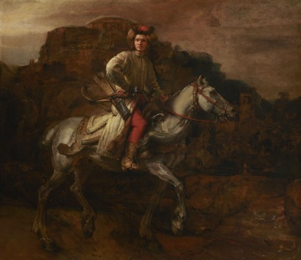
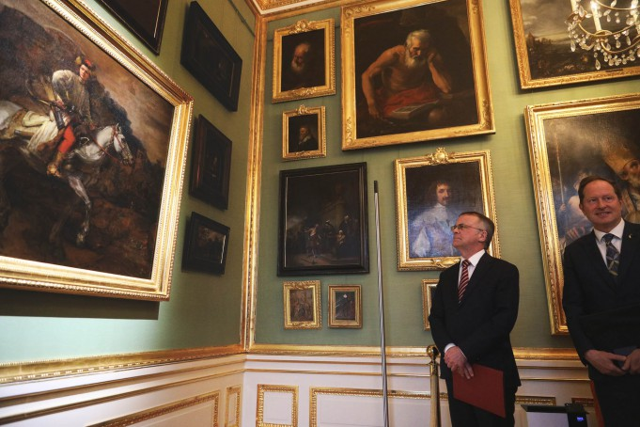
Royal Bathroom Park
One of Rembrandt's most recognizable works and only one of the two famous equestrian portraits by the Dutch master. The "Polish Rider", once in the collection of King Stanisław August, and now in the collection of the New York Frick Collection, will be presented from May 6 to August 7, 2022 at the Picture Gallery at the Palace on the Isle.
Notes:
‹#›

Slide 2
Ave Park
Ave Park is an indoor, heated, year-round skate park with an area of ​​less than 3000 m2. Designed in collaboration with TechRamps. In our facility there are both street and park obstacles - SOMETHING FOR EVERYONE! You can find more about the park and the obstacles in it in the PARK section.
Notes:
‹#›

Slide 3
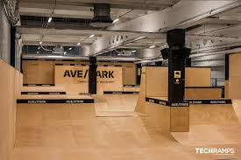
Ave park
Notes:
‹#›

Slide 4
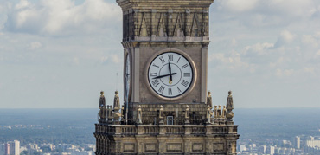
Palace of Culture
On New Year's Eve, December 31, 2000, the second largest clock in Europe was unveiled at the top of the Palace. The diameter of each of the 4 clock faces is 6.3 meters.
Notes:
‹#›

Slide 5
Kazoora Bike Park
In no way inferior to the professional routes that are prepared for the competition. Check what are currently available (open) and which you will be able to jump on in the near future.
Notes:
‹#›

Slide 6
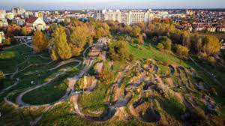
Kazoora Bike Park
Notes:
‹#›

Slide 7
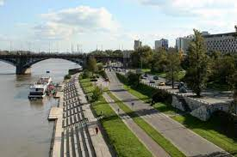
Rzeka wisła
The Vistula river, the queen of Polish rivers, has about 20 thousand. years. It was formed in the Pleistocene, when the great ice sheet, retreating through today's Mazovia, stopped. The warming of the climate caused enormous masses of water from the south to flow down the Vistula ice-marginal valley through today's Germany to the North Sea. The pre-Vistula riverbed was 18-20 km wide. Only the melting of the Scandinavian ice sheet and the emergence of the Baltic Sea redirected the pre-Vistula river to a new catchment area.
Notes:
‹#›

Slide 8
National Stadium
National Stadium Kazimierz Górski in Warsaw, from July 2015 also under the sponsorship name of PGE Narodowy - a multifunctional stadium in Warsaw, built in 2008–2011, before the 2012 European Football Championship, in the place of the 10th Anniversary Stadium. Officially opened on January 29, 2012.
Notes:
‹#›

Slide 9
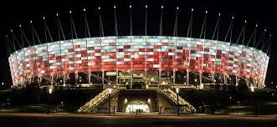
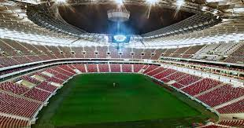
Notes:
‹#›

