Slide 1
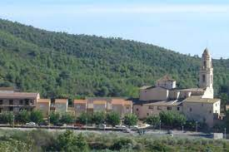
This is my town: Bonastre

Slide 2
HISTORY OF BONASTRE

Slide 3
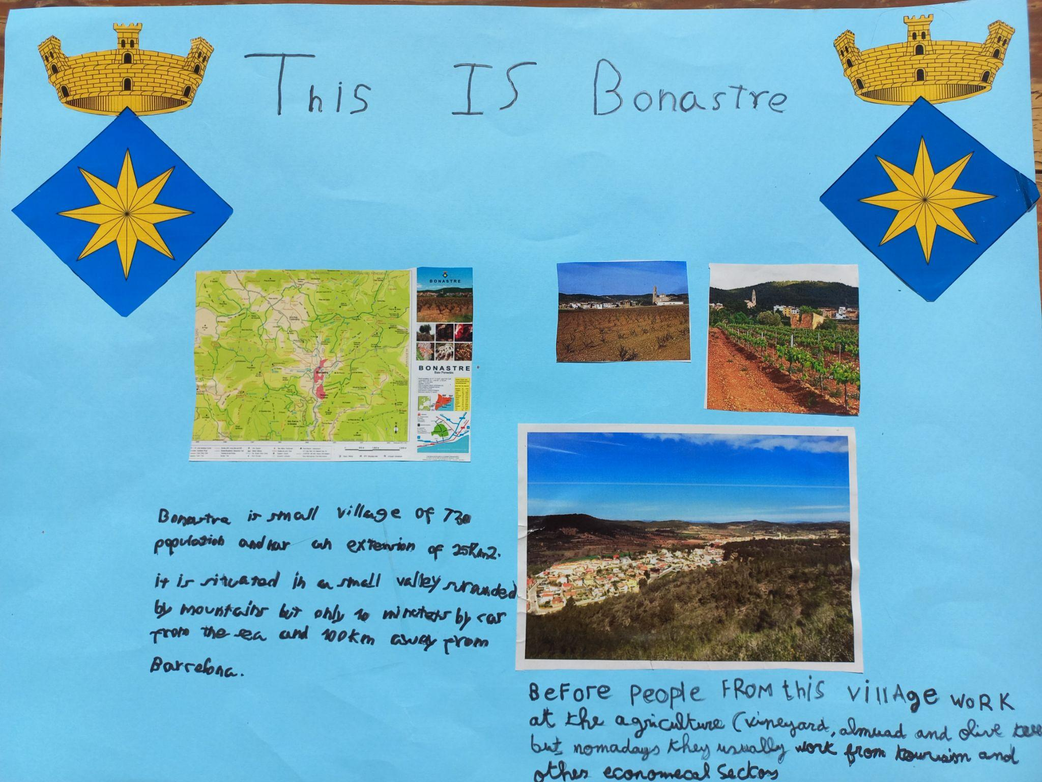

Slide 4
MAIN
BUILDINGS

Slide 5
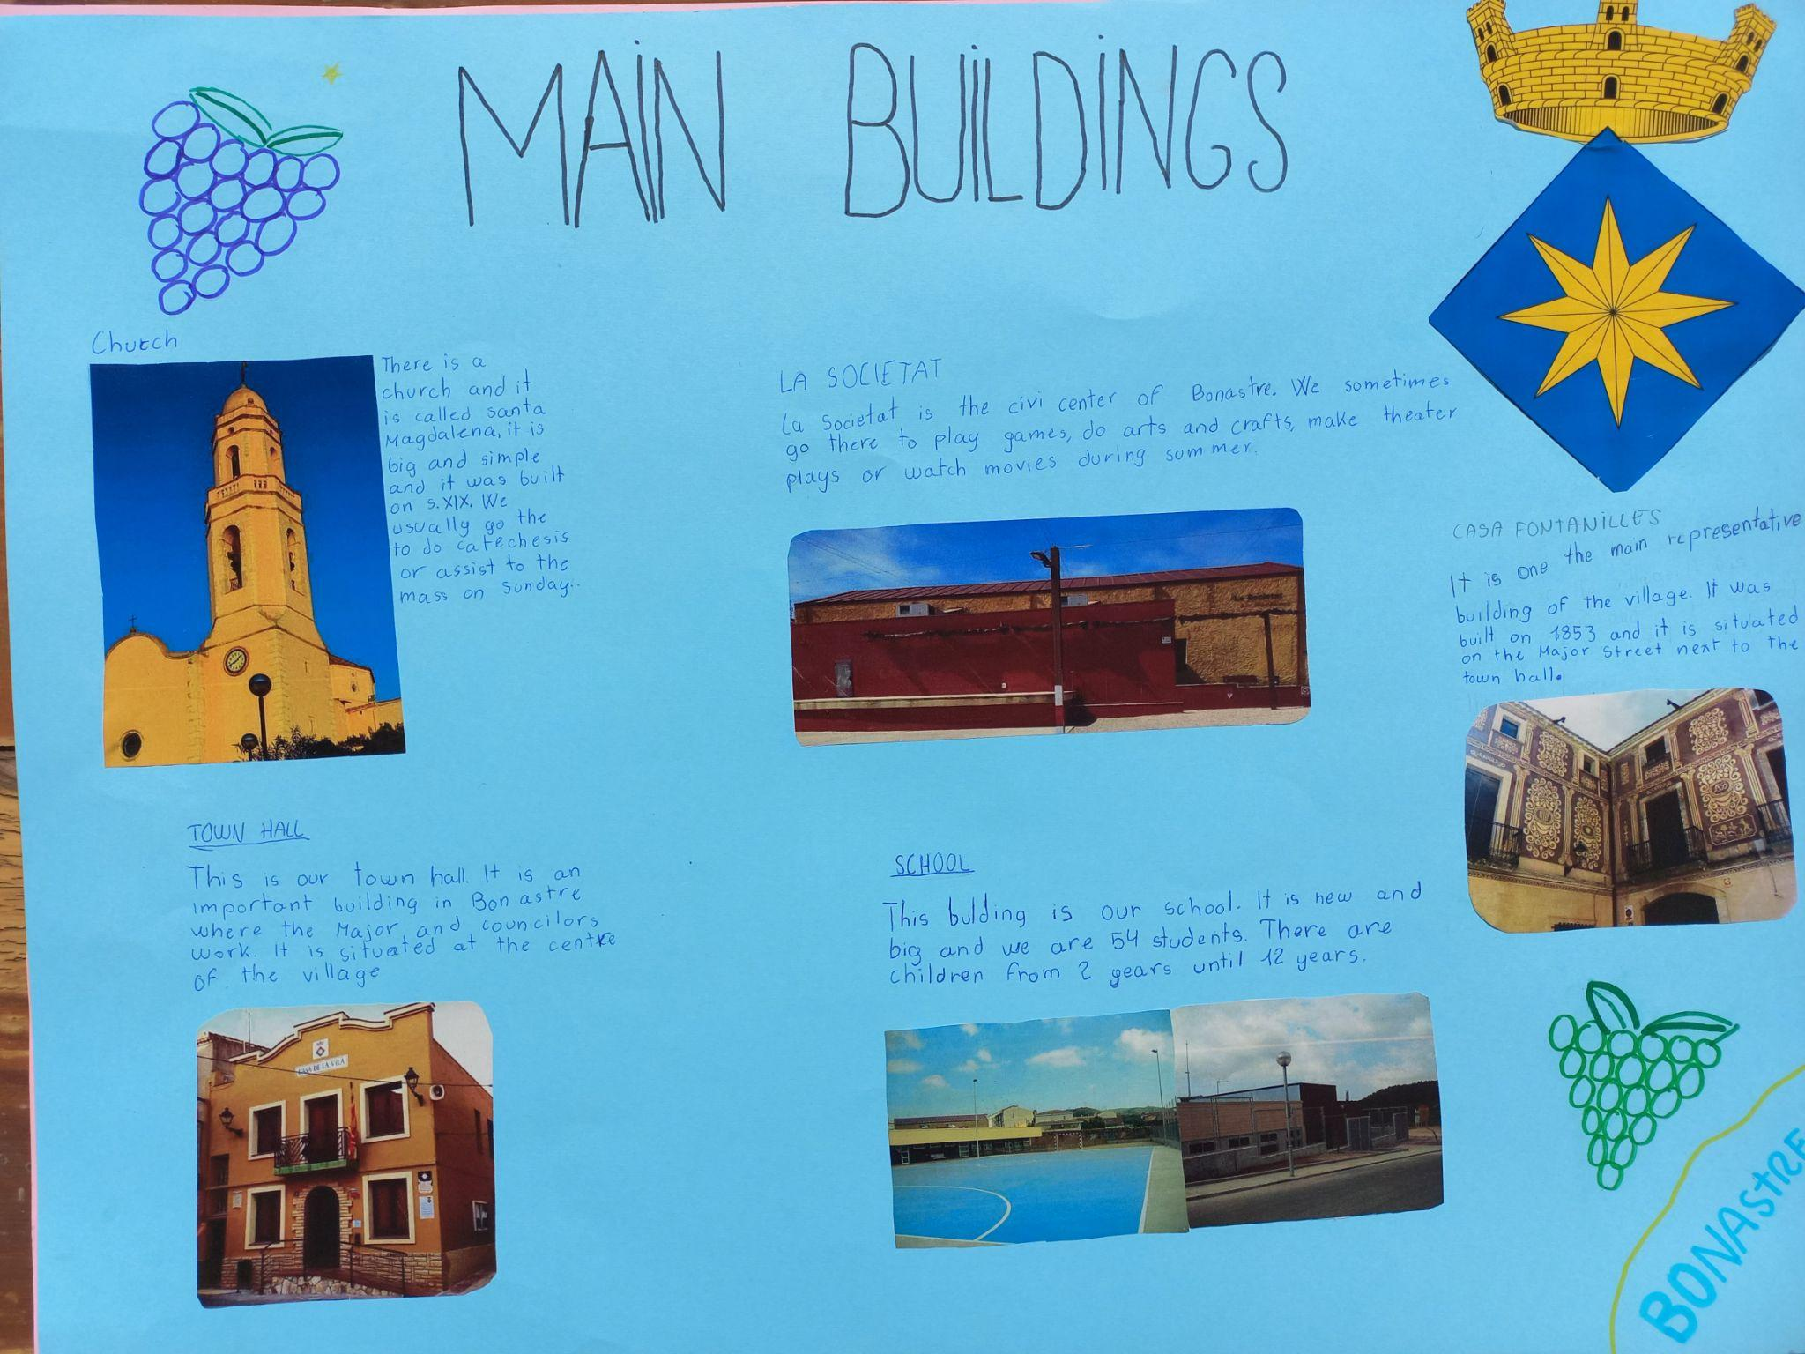

Slide 6
WHAT TO DO IN BONASTRE

Slide 7
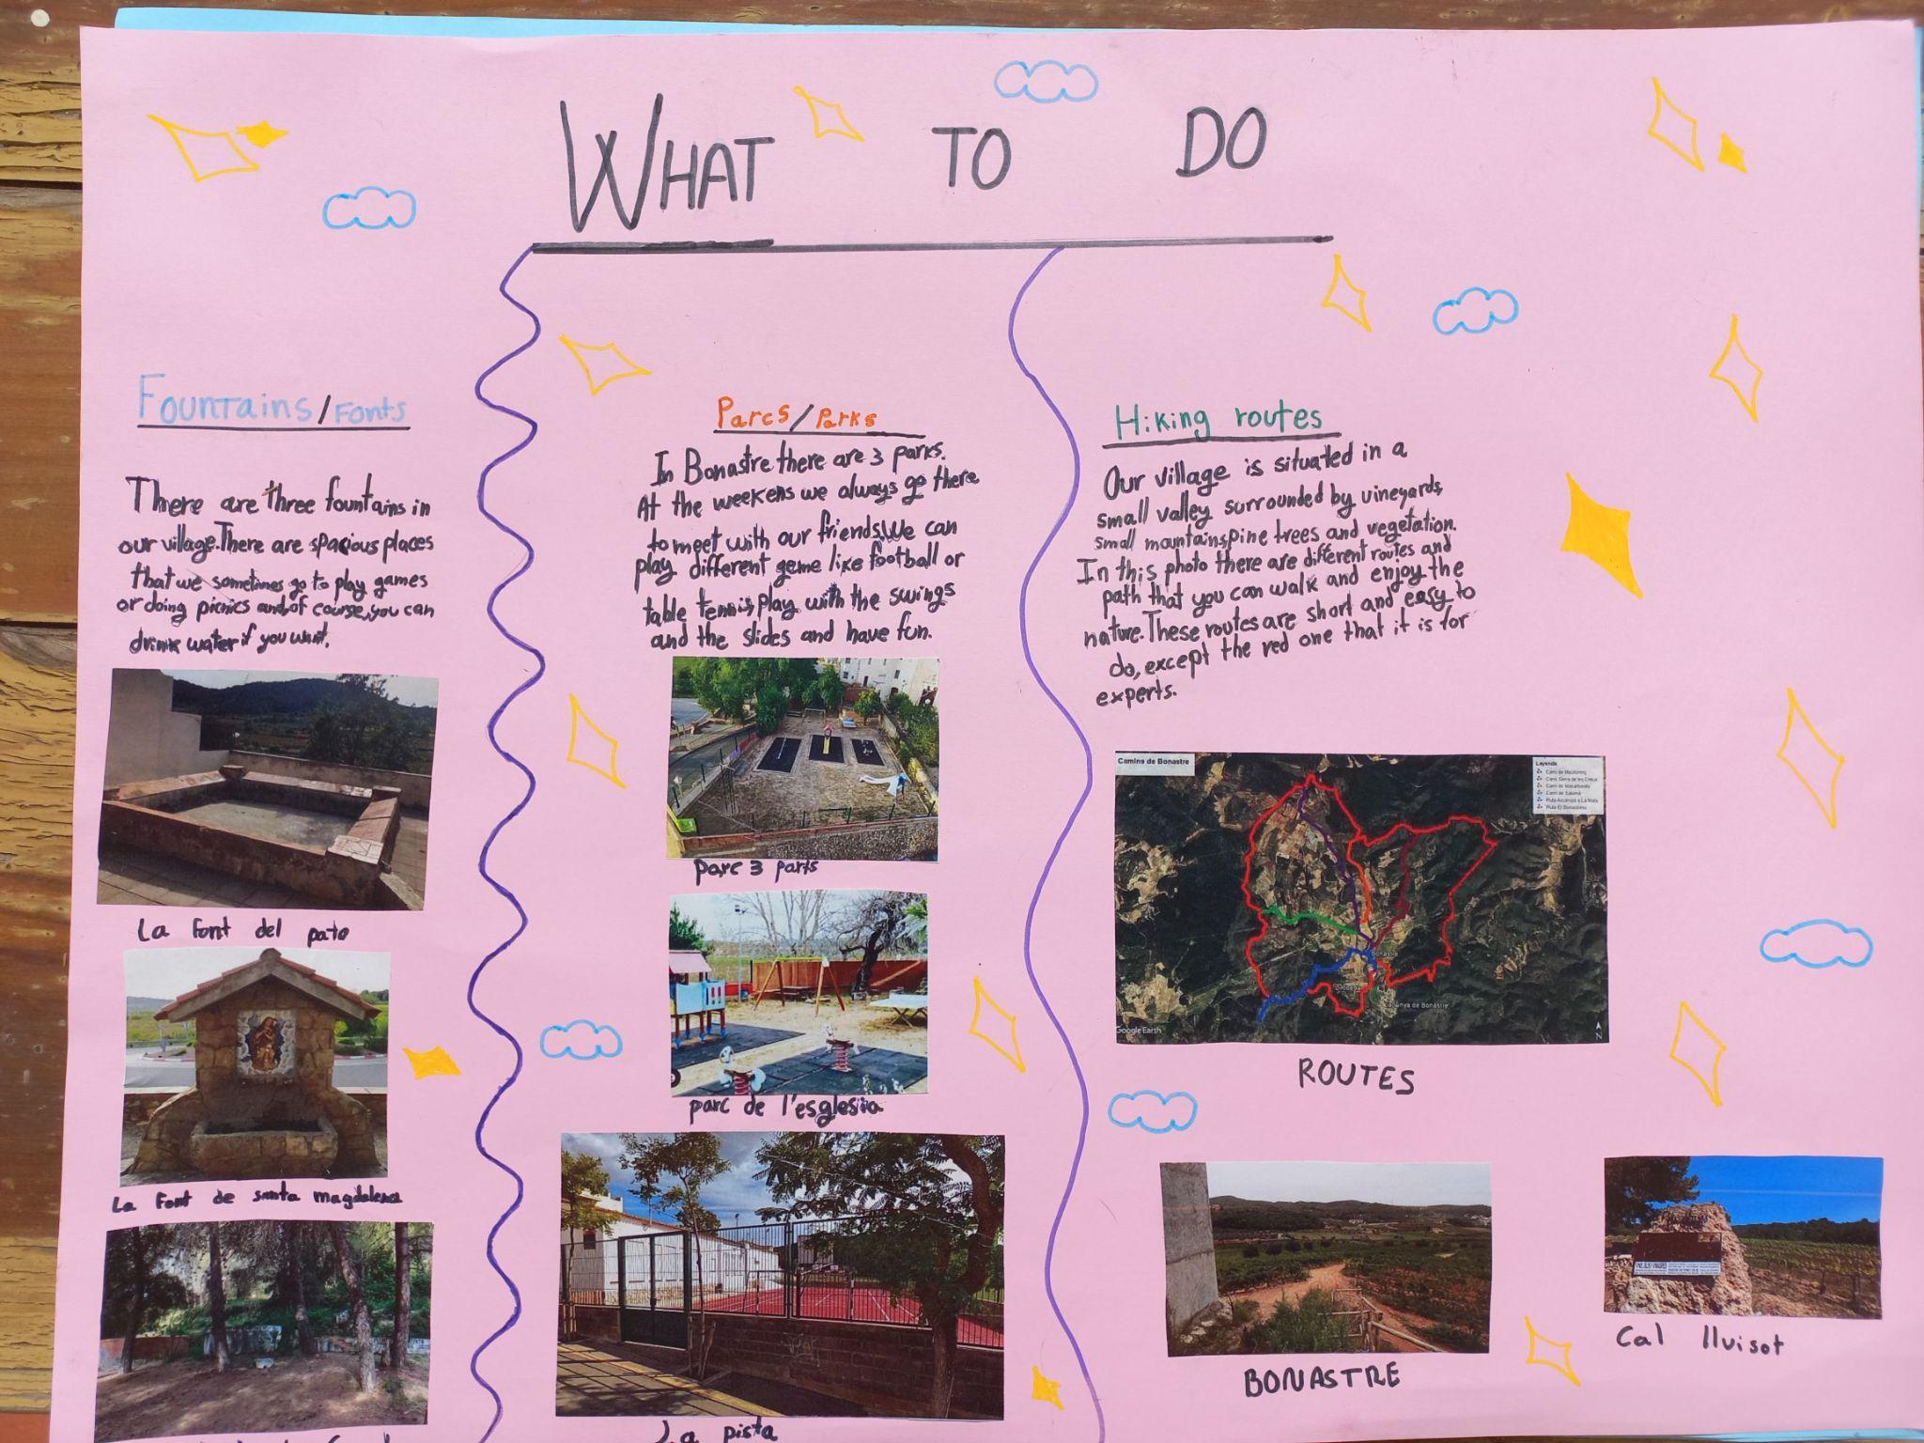

Slide 8
CULTURAL
FESTIVITIES

Slide 9
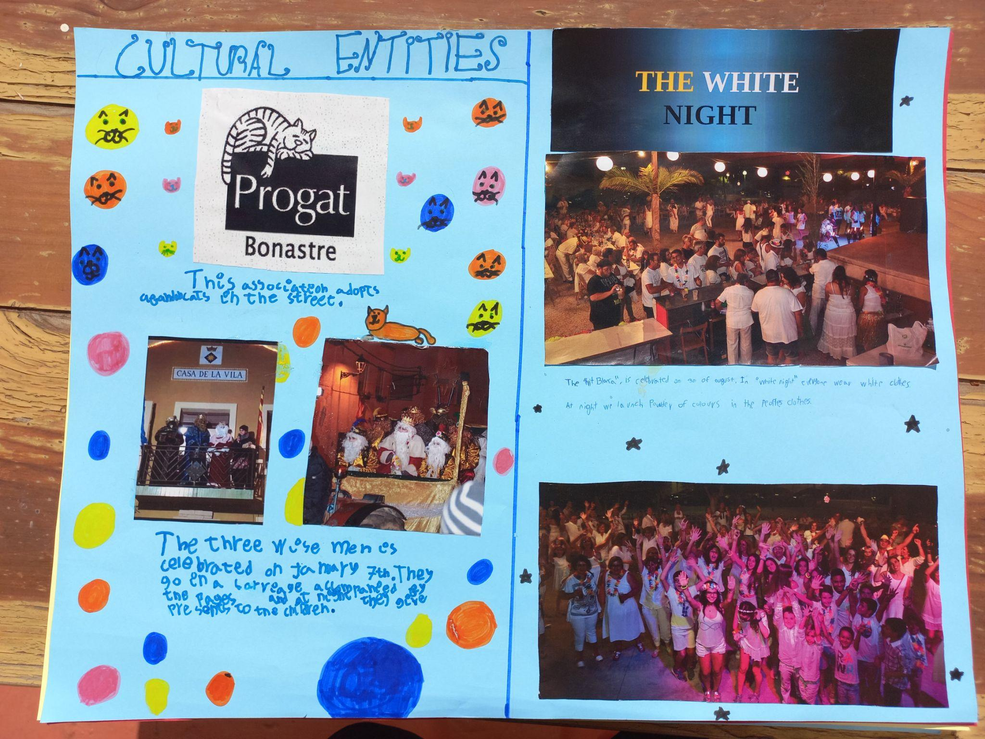

Slide 10
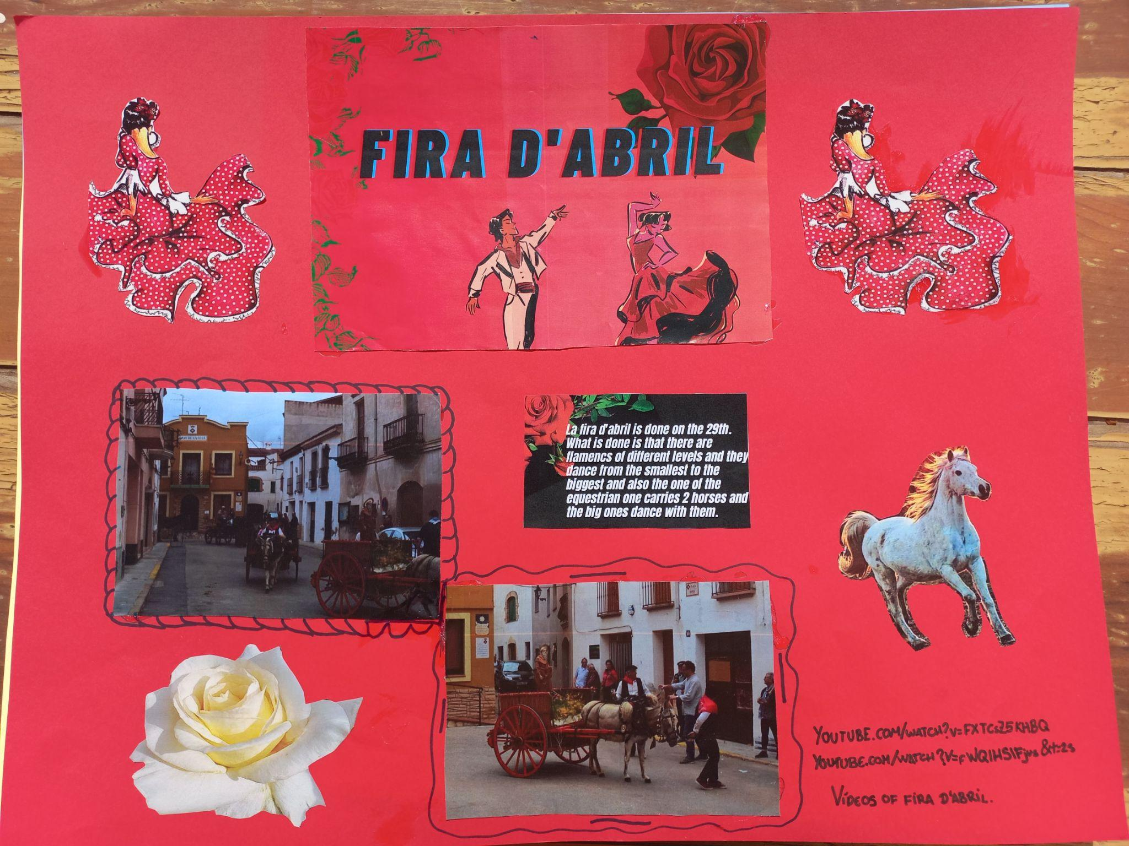

Slide 11
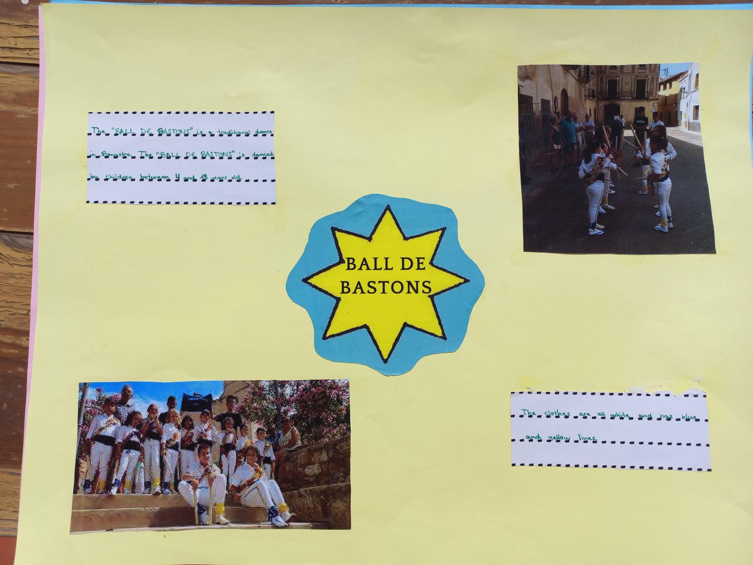

Slide 12
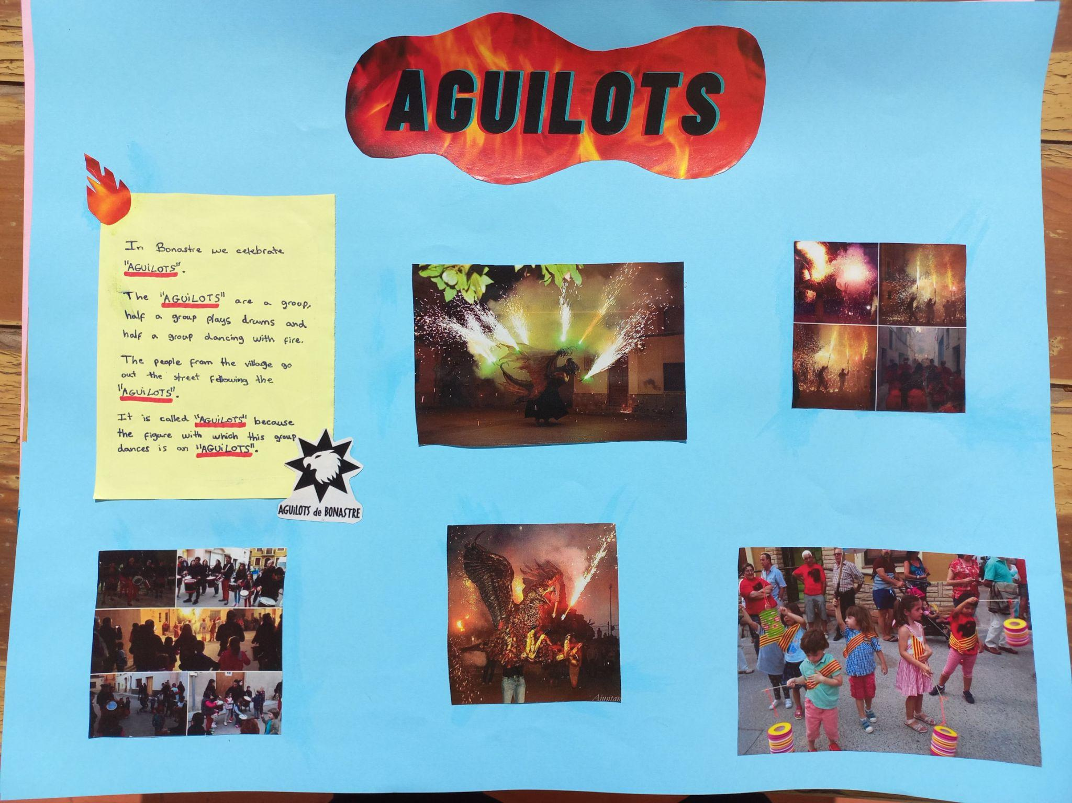

Slide 13
